Slide 1
Y Chromosome Analysis

Slide 2
Y chromosome in cancer : Landscape so far
Earlier studies have reported that genetic variation in chromosome Y (ChrY) regulates susceptibility to infectious diseases. Recently, using genotype-array-intensity data and sequence reads from 85,542 men identified 19 genomic loci associated with mLOY (mosaic loss of Y), including regions involved in DNA synthesis, DNA damage response, mitosis, and apoptosis, thus linking mLOY with cancer susceptibility
Loss of Y chromosome in hematopoietic cells is a positive indicator of cancer in older males
KDM5D is a histone demethylase located on ChrY is shown to be associated with
aggressive features and poorer prognosis
docetaxel resistance.

Slide 3
To determine the mutational landscape of the Y chromosome (ChrY) in PC
Specific Objectives:
Identify samples with ChrY loss and quantify the focality of ChrY loss
Assess mutual exclusivity of ChrY loss with genomic lesions in prostate cancer pathways
Correlate of ChrY alterations with Gleason score and sample type
Define the mutational landscape of ChrY and determine if the chrY loss is significantly associated with disease risk

Slide 4
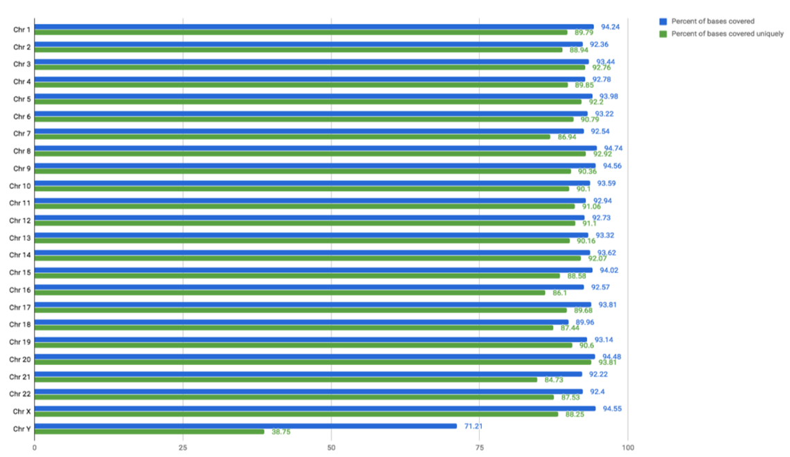
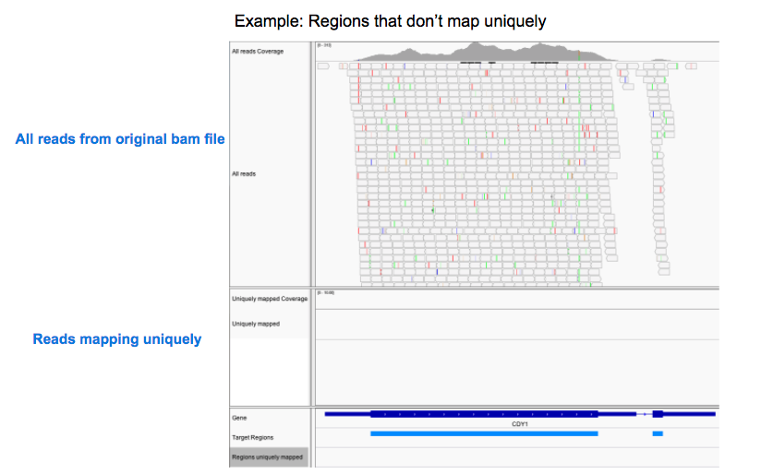
Somatic variant calling of most chrY genes is challenging.
BN and SN

Slide 5
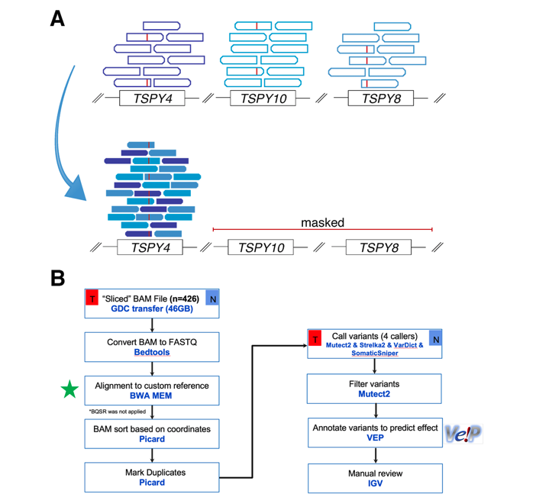
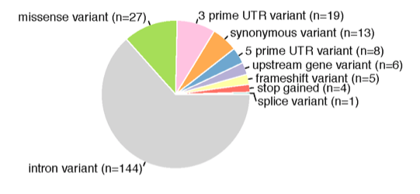
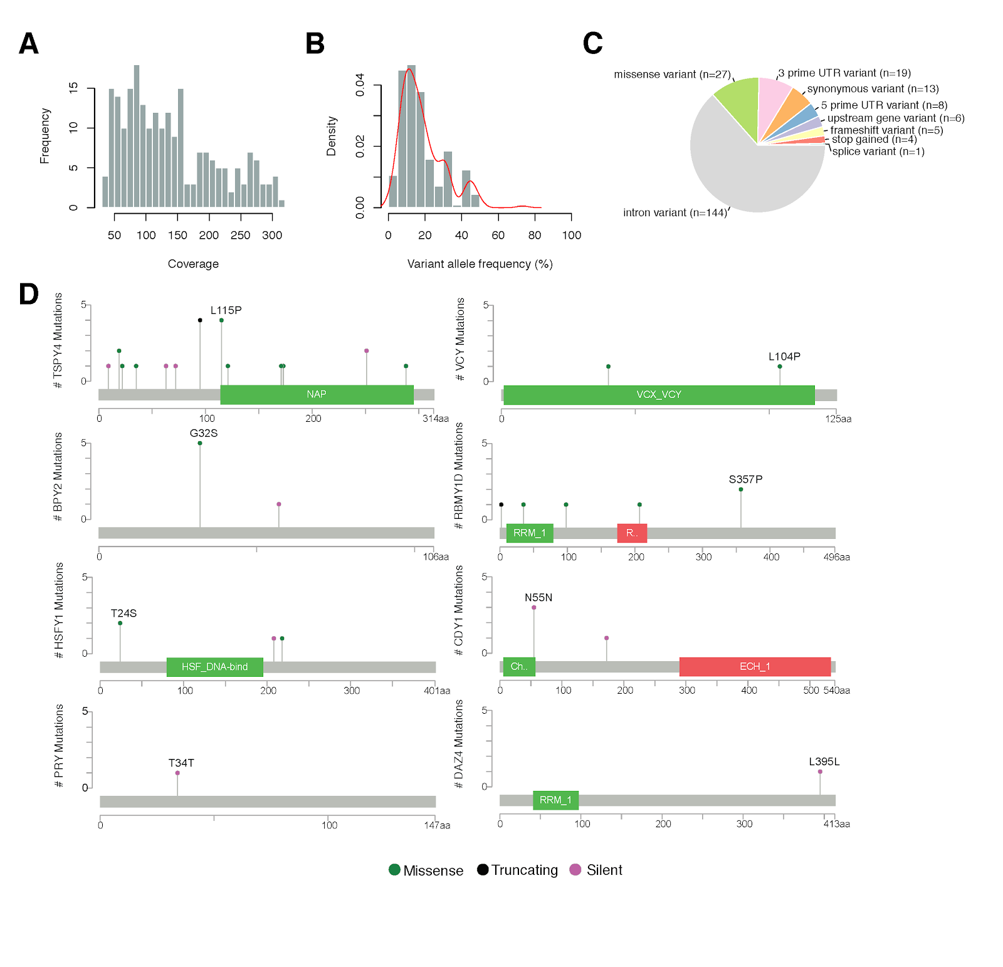
In a first attempt of reporting the mutational landscape of ChrY in PC we developed a new method to specifically call mutations in paralogs families of chrY in TCGA (29 out of 44 genes belong to paralog family)
BN and SN

Slide 6
Overview : Calling Y chromosome loss
Methological suitability
Data logistics
Y-chromosome structure
The definition of Y-chromosome loss
What can be learned from WES:IMPACT mismatches
Genomic correlates with Y-chromosome loss
https://github.mskcc.org/kreitzeC/Y-chromosome-loss

Slide 7
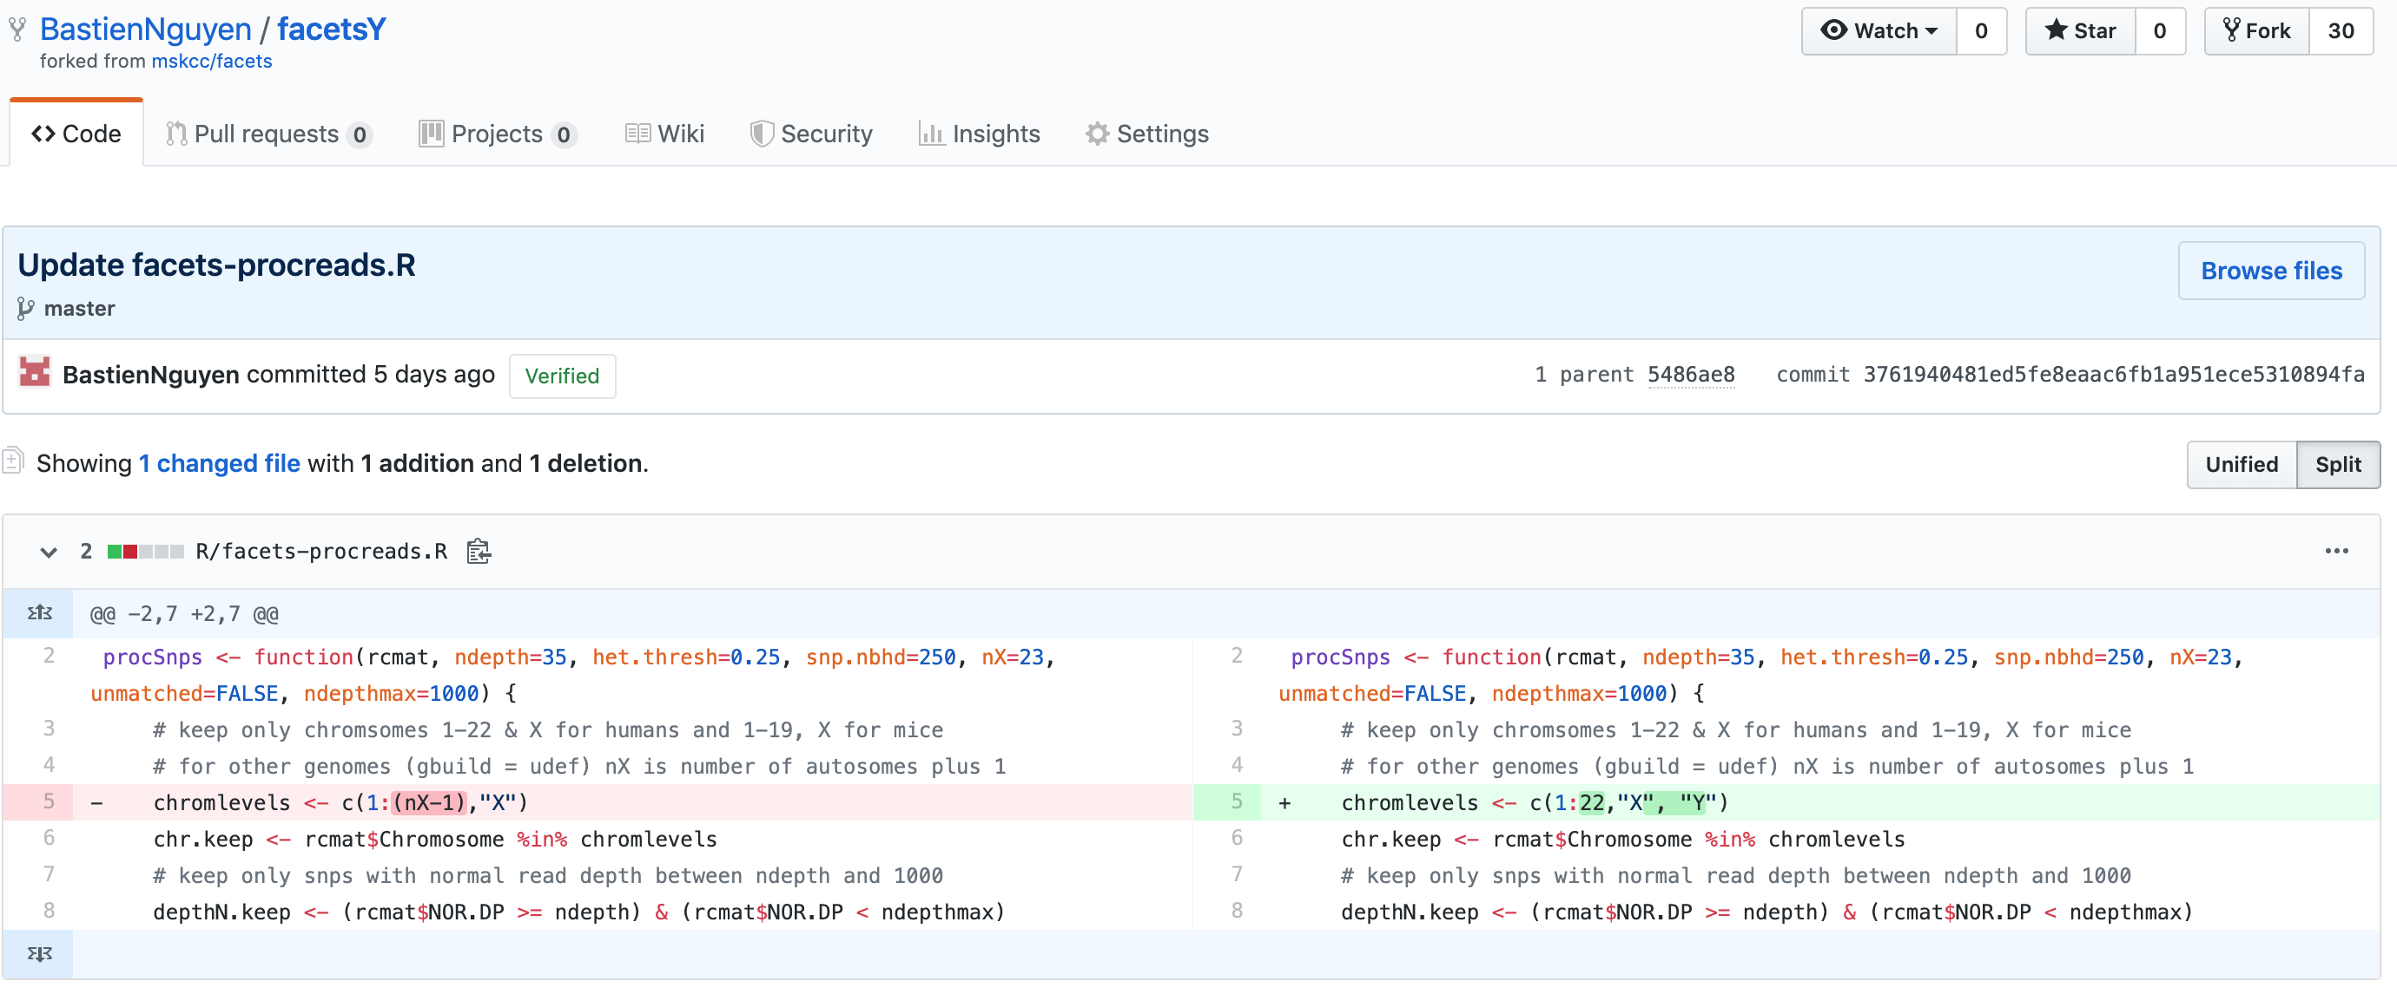
FacetsY: standard Facets-pipeline which considers data (seq reads) coming from the Y-chromosome
Big credits to Bastien

Slide 8
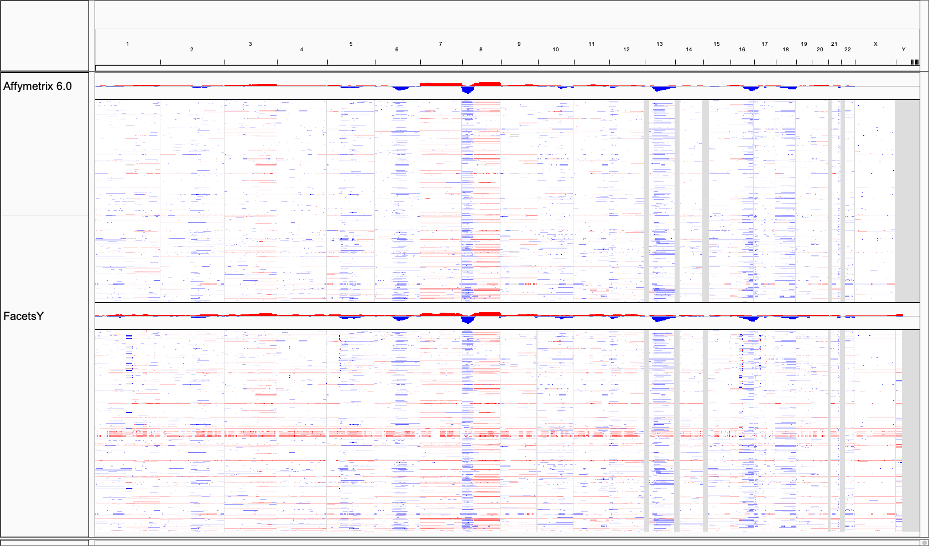
FacetsY depicts a reliable tool for SCNA profilling FacetsY comparison to Affymetrix data in TCGA-PRAD (n=333) samples
Continuous segmentation data (IGV)
Arm-Level alteration
Gene-expression

Slide 9
Data logistics: Whole exome and IMPACT-panel seq data
Total of 3,221 WES samples (as of 11/2020)
we concentrate on n=238 prostate cancer samples
https://delphi.mskcc.org/sample-tracker/home
We do have corresponding IMPACT-Panel Seq data

Slide 10
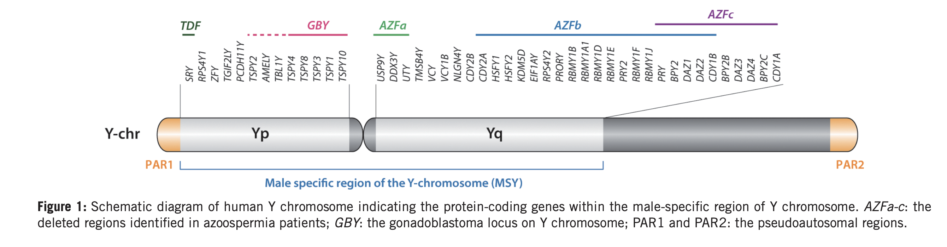
Y-chromosome architecture and Seq-resoltuion using WES
Largely repeating DNA segments
PARs undergo recombination
Large parts of Yq [MSY] are heterochromatin
Pseudogenes, long- short non-coding RNAs;
54 genes with protein-coding potential:
-> only 27 code distinct MSY proteins)
*Marker(s):
Position on the Y-chromosome where Seq.-Reads in both
Tumor/Normal overcome QC and hence retain for segmentation

Slide 11
IMPACT-Panel Seq data is sparse
The Y-chromosome information content in WES-sample is high

Slide 12
How to define a Y-chromosome loss: ‘50%-rule’
tcn = 1
tcn=0
Individual markers
[Tumor:Normal CnLR]
If segment(s) with tcn=0 are > 50% of Y-chromosome
(Especially dangerous when applied to IMPACT data)

Slide 13
A continuous approximation to FacetsY binary calls brings a few advantages
original → binary
mCnLR → continiuous
tcn = 1
tcn=0
Individual markers
[Tumor:Normal CnLR]
Individual markers
[Tumor:Normal CnLR]
Comparison between methods (WES and IMPACT Seq)
Detect faulty tcn calls (more later)

Slide 14
The overall agreement rate on Y-chromosome losses between WES and IMPACT is high
Sanity checks
Y-chromosome calls of 81.7% (n=238) between WES and IMPACT samples match
(17.1% loss; 82.9% intact Y-chromosome)

Slide 15
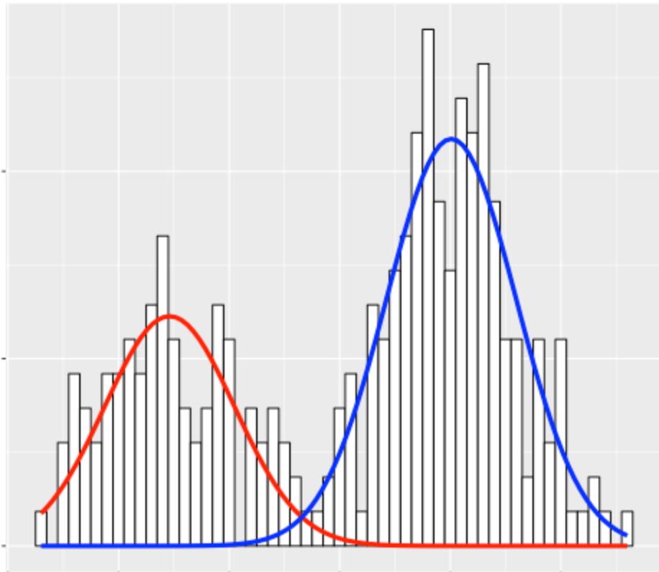
Can we rescue the 20% mismatched samples? Gaussian mixture model: dummy example
Two distinct clusters
~60% input within blue cluster
~40% input within red cluster
density
cnlr

Slide 16
Let’s look into one mismatched example
procedure
GMM
(two components)
IMPACT
mCnLR = 0.10
[94%] markers
No loss
>75% input fall within one cluster
determine max of respecitve cluster
WES
mCnLR = -0.17
[88%] markers
No loss
< abs(0.2*) = loss
*widely supported in literature

Slide 17
Another mismatch example (focal change?)
Ambiguous: will be excluded

Slide 18
n=238
PRAD samples
FacetsY
n=186
QC=TRUE
n=152
match
n=34
mismatch
GMM
n=126
intact
n=26
loss
n=13
intact
n=10
loss
n=10
ambiguous
19.4% Y-chromosome loss in prostate cancer cohort (where both WES and IMPACT are available)
5.7% Y-chromosome loss in TCGA-PRAD cohort (Cell, 2015)

Slide 19
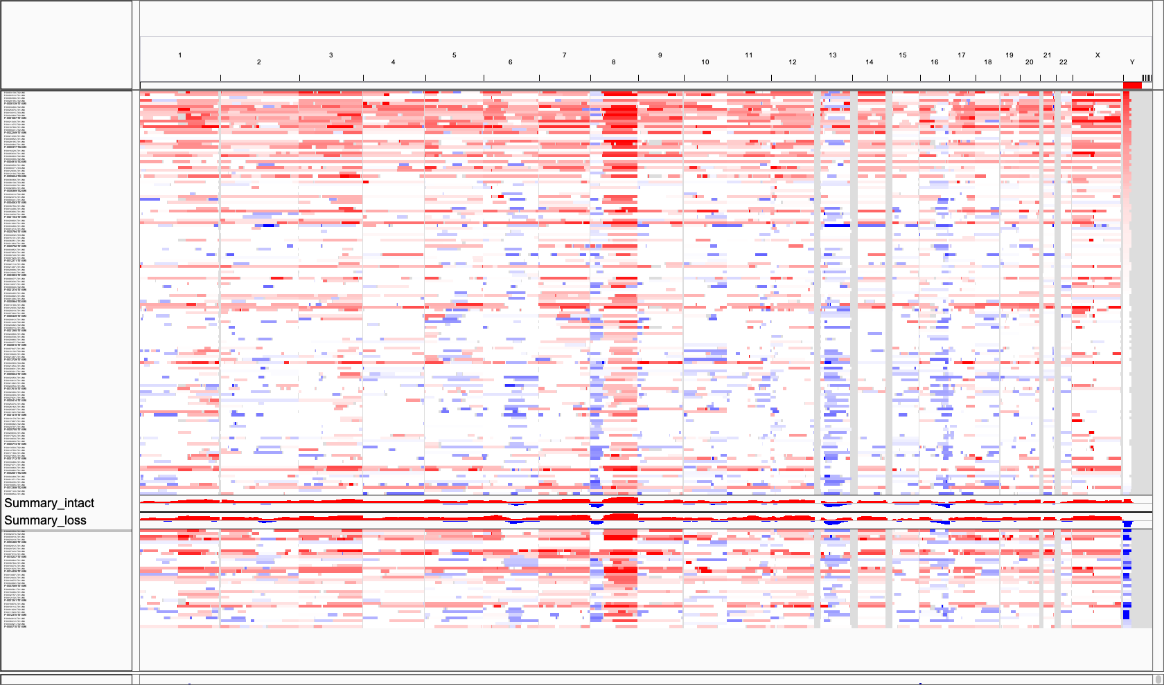
Genomic correlates; is the Y-chromosome loss a unique event?
Y-chromosome intact
loss
There is no clear association yet with Y-chromosome loss (due to sample size?)
Or a unique event?

Slide 20
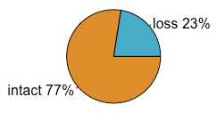
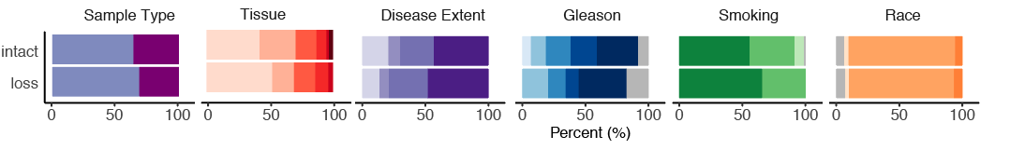
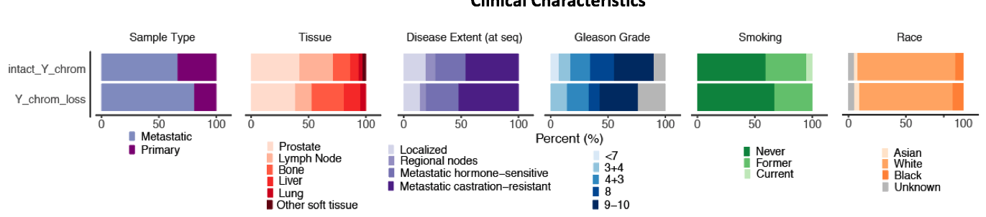
Clinical and Genomic Associations
n=30
Y loss in WES samples
n=103
Clinical
Characteristics
Genomic
Variables

Slide 21
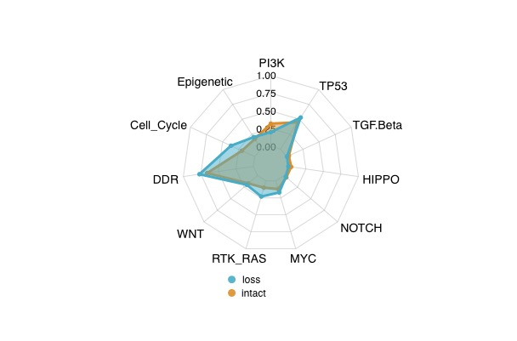
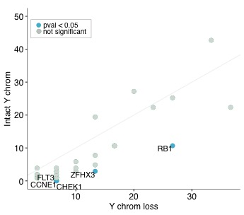
Gene Enrichment
Oncopath

Slide 22
Overall Survival (All Samples)
Unadjusted HR: 1.9 (1 - 3.5) , p = 0.04
Adjusted Model 1:
HR: 1.3 (0.69 – 2.5 ) p = 0.46 (Covariate: FGA)

Slide 23
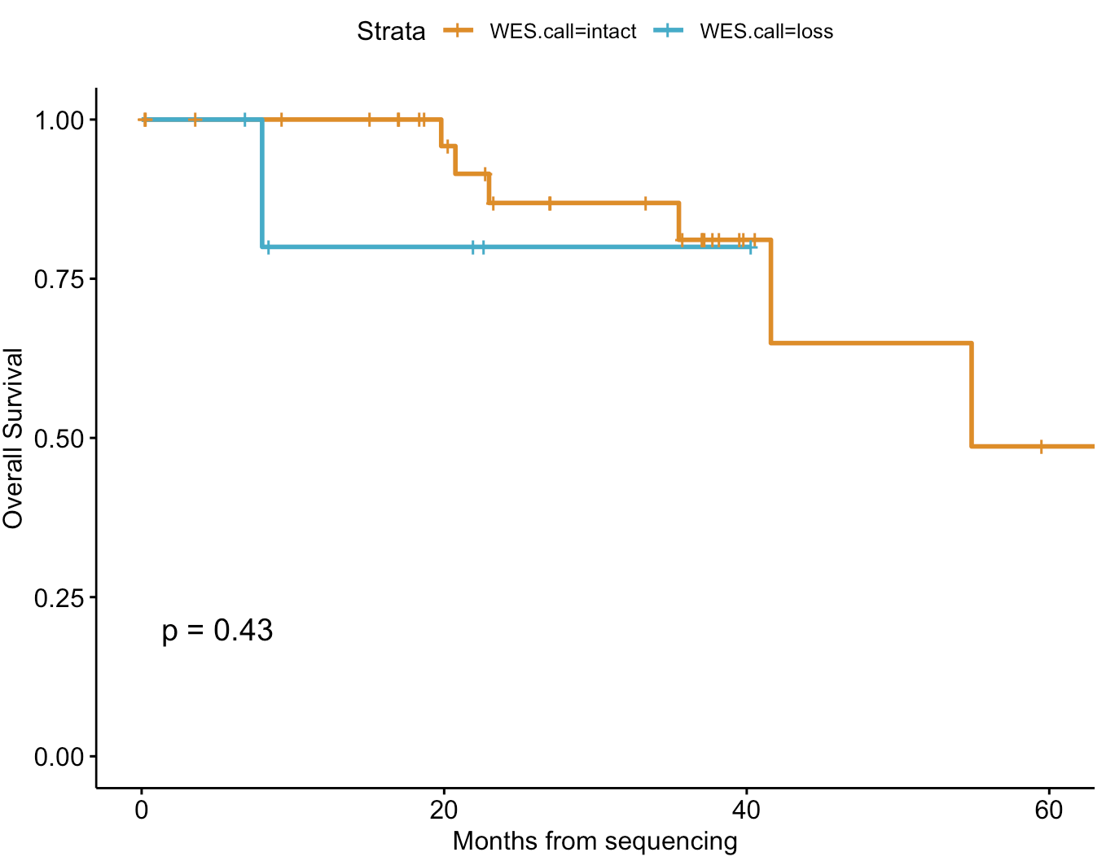
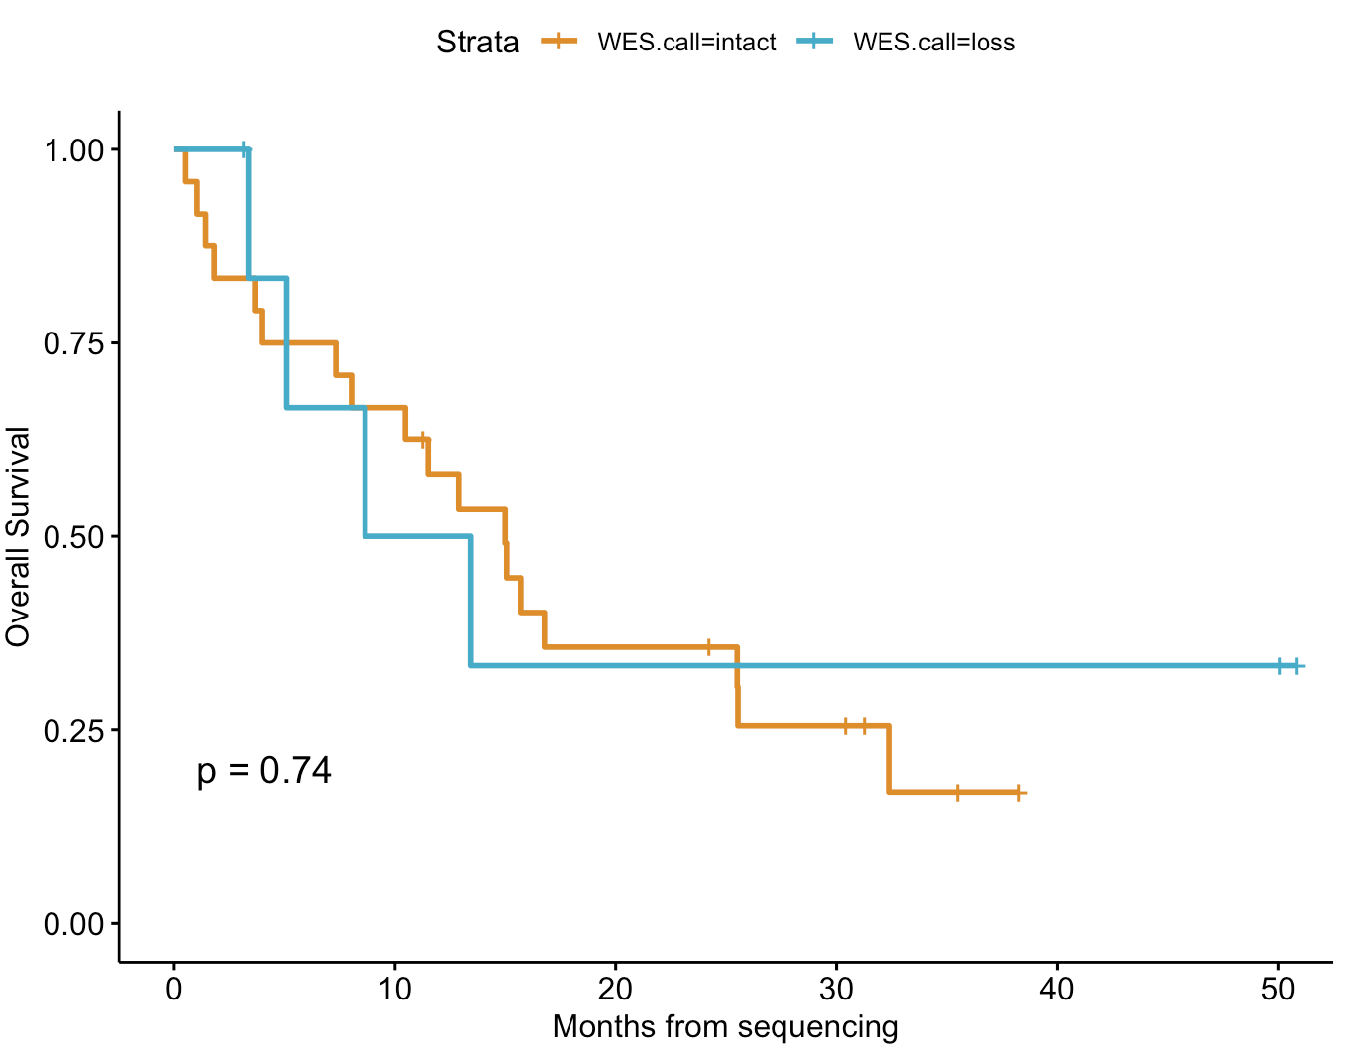
Primary
Mets

Slide 24
Next Steps
Use the same method to call pan cancer chrY loss (WES and IMPACT)
Functional analysis of target genes from the CRISPR screens (enzalutamide and docetaxel) is underway. Phenotypes such as growth rate, migration rate, and drug sensitivity are being investigated.

Slide 25
Updates on Y-chromsome loss

Slide 26
Content
Background (what we did so far)
If we talk about a Y-chromosome loss, we also need to consider mosaic-loss of Y chromosome
Talking about methological suitability (PanCancer Level)
Overview cohort
Association studies

Slide 27
Background
We concentrated on Prostate Cancer Samples (n= 158)
We proofed that the concept is working (verify that IMPACT is equally suitable for calling Y-chromosome loss)
Gaussian-Mixture model
And we showed that there is a tight association of Y-chromosome loss and FGA
We also showed that the OS is lower in patients with a Y-chromosome loss
19.4% Y-chromosome loss in prostate cancer cohort

Slide 28
PanCancer Study overview (FlowDiagram)[11/01/2021]
Talking about several aspects
Short background (what we did so far)
mLOY (mosaic loss of Y-chromosome)
PanCancer overview
Finding markers (for Y-chromosome loss)

Slide 29
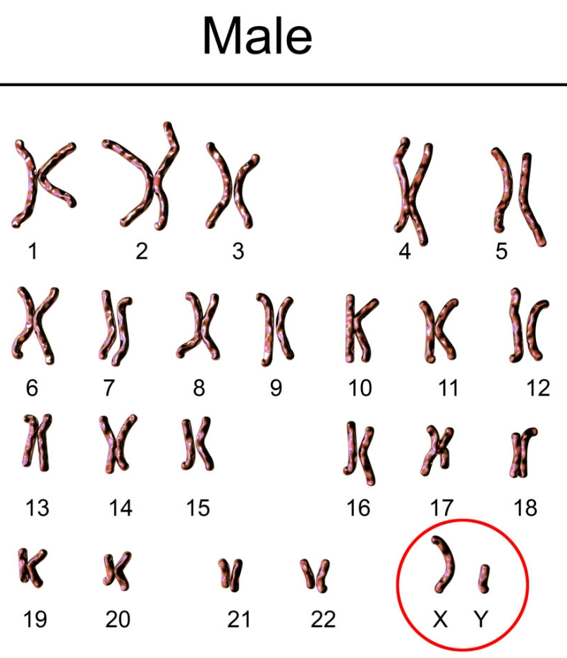
somaticMosaicism
Loss of Chromosome Y in somatic cells of aging men has been observed for more than 50 years.
… and is associated with numerous genetic diseases and cancer mortality
Mosaicism
Age

Slide 30
Detection of Y-chromosome mosacism from sequencing data is a novelty
Most (99%) are on SNP-arrays or ddPCR
Adapted a method similar to those with ArrayIntensity data
Marcus Danielsson (Lars Forsberg), Zhao Y (John Perry), Machiela Mitchell (Chanock Stephen), Peter Priestly
Chromosome Y has a tumor suprresor function (hypothesis)
Autosomes / allosomes (GC solid)
Peak-correction (population-wise)

Slide 31
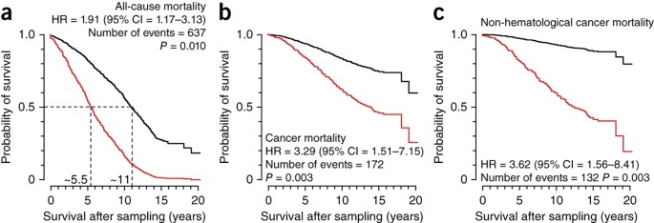
In general the literature claims that mosaic loss of Y-chromosome is commonly associated with age …
Moreover, mLOY is associated with all-cause mortality
Lars A Forsberg, et al. Nature 2014

Slide 32
We don’t see a particular increase in mLOY with age (however) look at the number
mLOY is associaed with age (the older, the higher the percentage of mLOY)
Y-chromosome loss in cancer is age-independent ()
Hence, proof that Y-chromosome loss is independent entitiy in cancer progression
LOY is tissue dependent
I believe that you will find LOY caused by cancer as genetic imbalance is to be expected.

Slide 33
But we do see that cancer-patients with an intact Y-chromosome in the blood do overall better (several hypothesis about this)

Slide 34
Why are we including Y-chromosome mosaicism in our study?
Imagine that we have a ‘normal’ sample with no Y-chromome (due to mosaicism) – we use this normal to calculate the ‘tumor sample’.
Well, if there is no Y chromosome in the normal – the tumor must equally be without a Y-chromosome (not due to biological reality – just because methological restrictions (T/N ratio – cnLR).

Slide 35
How to proof that mosaic loss and Y-chromosome loss are two different entities?
 | No Mosaic | Mosaic
Intact Y-chromosome | 4,155 | 4,019
Y–chromosome loss | 2,128 | 1,833
?
Mosaicism doesn’t mean that there is no Y-chromosome info at all. Its just
that the overall Y-DNA concentration is lower (subset of cells)
Chi-squared p = 0.002978 (Mosaic and Y chromosome loss are dependent on each other

Slide 36
There is no association of germline copy number (mosaicism) with copy number in tumor – so these are two different entities
p = 0.15, cor = 0.13

Slide 37
y = 0.52 -0.89x
p=<2e-16
The higher the Germline DNA content, the lower the Y-chromosome copy number in solid tumor tissue
Check out two examples
There is no obvious connection?
I checked purity, coverage issues, manually
r = -0.12
R² = -0.014

Slide 38
 | No Mosaic | Mosaic
Intact Y-chromosome | 162 | 118
Y–chromosome loss | 214 | 112
truely caused by cancer?

Slide 39
 | No Mosaic | Mosaic
Intact Y-chromosome | 162 | 118
Y–chromosome loss | 214 | 112
Loss due to physiology OR CANCER

Slide 40
We see a similar trend; so the question is
Does the Y-chromosome loss just occur because of normal aging or is there indication that a tumor specifically kicks away the Y-chromosome (which would be indicative of direct selection (positive) or negative –
If negative (the Y-chromosome has tumor suppressive functions)

Slide 41
mLOY is associated with age (as shown)
snp.nbhd = 250
gcpct >= 0.45 & <= 0.55 (as suggested)
min. coverage 35 reads
Sliding Windows = 1,000 bp OR 1 kb
Everyting < 100 bp → neglected

Slide 42
Chromosome Y loss is a cause or the consequence of tumor?

